Slide 1
Data Structures & Algorithms (CSC-214)
Linked List

Slide 2
Pointers-Based Implementation of Lists (Linked List)

Slide 3
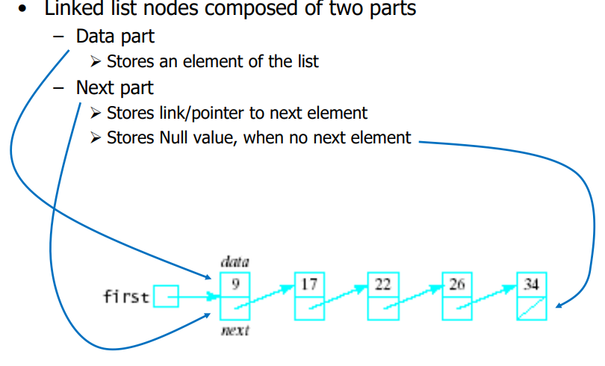
Linked List

Slide 4
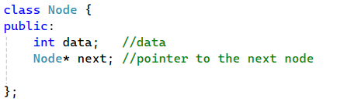
Simple Linked List Class (1)
We use two classes: Node and List
Declare Node class for the nodes
data: double-type data in this example
next: a pointer to the next node in the list

Slide 5
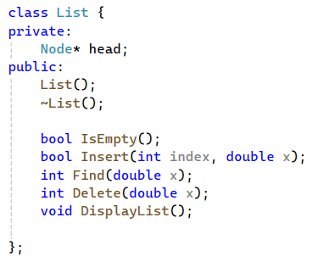
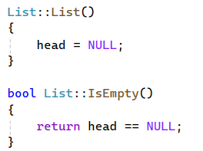
Simple Linked List Class (2)
Declare List, which contains
head: a pointer to the first node in the list
Since the list is empty initially, head is set to NULL

Slide 6
Simple Linked List Class (3)
Operations of List
Insert: insert a new node at a particular position
IsEmpty: determine whether or not the list is empty
Find: find a node with a given value
Delete: delete a node with a given value
DisplayList: print all the nodes in the list

Slide 7
Insertion

Slide 8
Inserting a New Node
bool Insert(int index, double x)
Insert a node with data equal to x after the index elements
If the insertion is successful: Return true, Otherwise: return false
If index is <= 0 or > length of the list, the insertion will fail
Steps
1. Locate the element at the index position
2. Allocate memory for the new node, copy data into node
3. Point the new node to its successor (next node)
4. Point the new node’s predecessor (preceding node) to the new node

Slide 9
Inserting a New Node
Possible cases of Insert
1. Insert into an empty list
2. Insert at front
3. Insert at back
4. Insert in middle

Slide 10
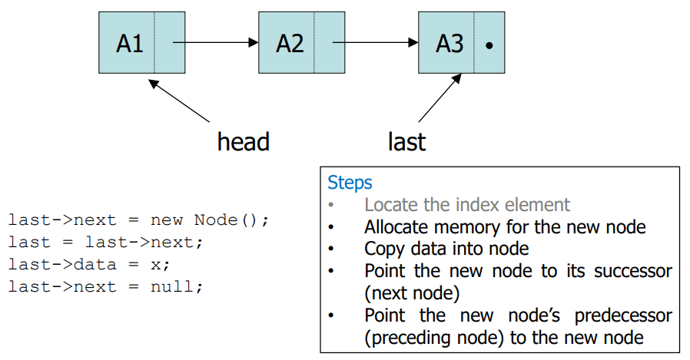
Insertion After The Last Element (1)
Suppose last points to the last element of the list
We can add a new last item x by doing this

Slide 11
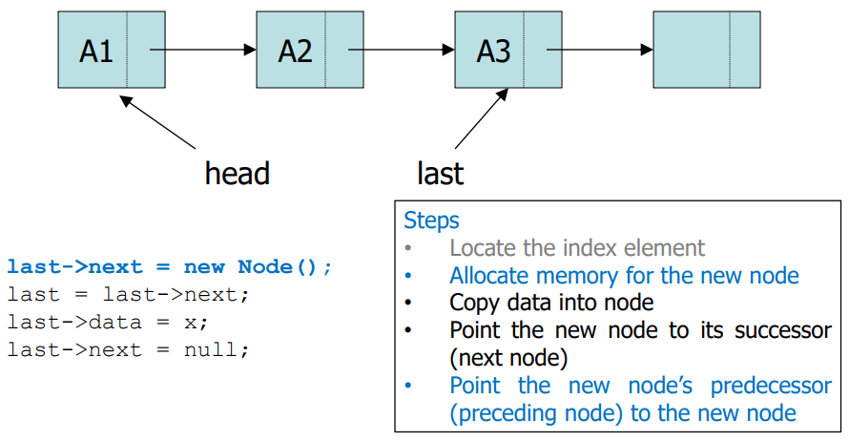
Insertion After The Last Element (2)
Suppose last points to the last element of the list
We can add a new last item x by doing this

Slide 12
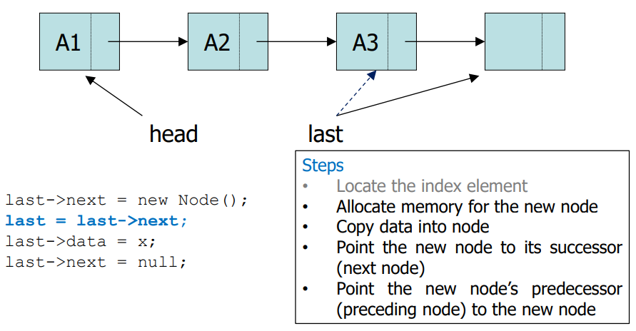
Insertion After The Last Element (3)
Suppose last points to the last element of the list
We can add a new last item x by doing this

Slide 13
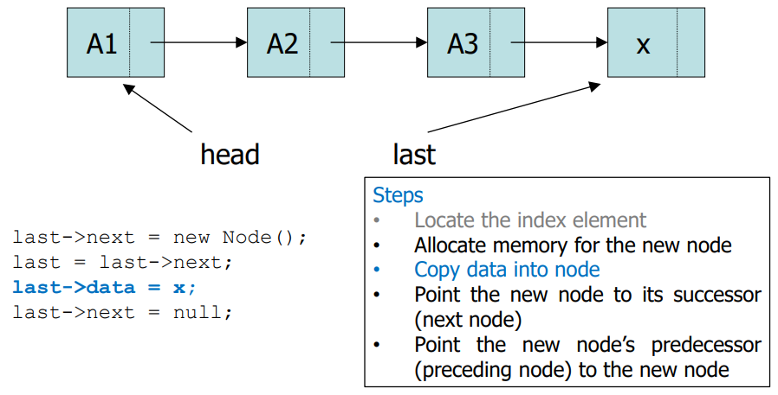
Insertion After The Last Element (4)
Suppose last points to the last element of the list
We can add a new last item x by doing this

Slide 14
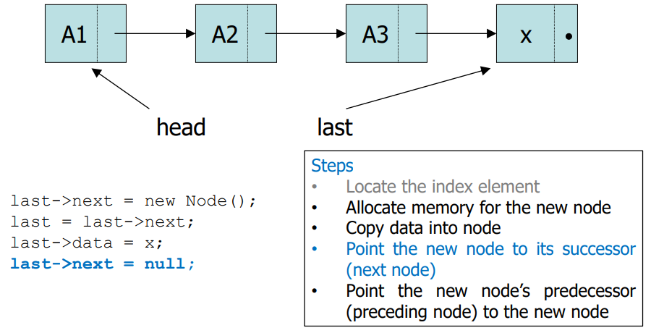
Insertion After The Last Element (4)
Suppose last points to the last element of the list
We can add a new last item x by doing this

Slide 15
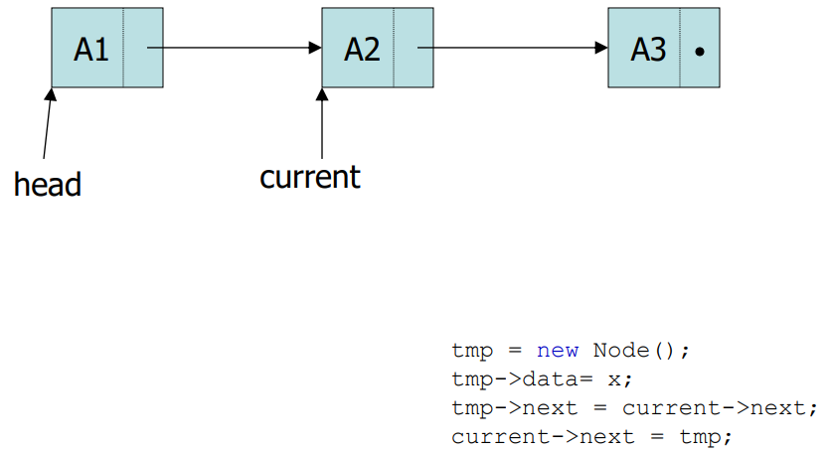
Insertion At The Middle (1)
Suppose current points to the middle element of the list
We can add a new item x by doing this

Slide 16
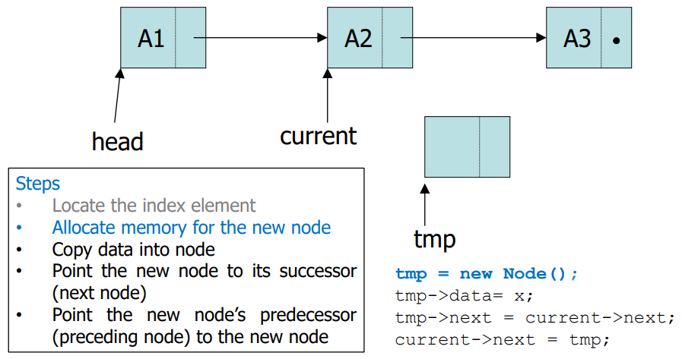
Insertion At The Middle (2)
Suppose current points to the middle element of the list
We can add a new item x by doing this

Slide 17
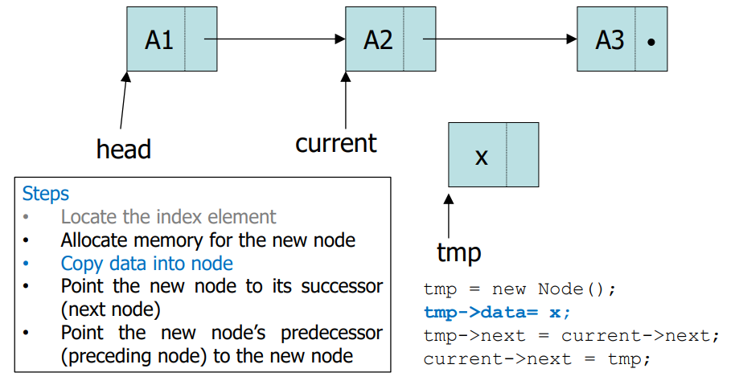
Insertion At The Middle (3)
Suppose current points to the middle element of the list
We can add a new item x by doing this

Slide 18
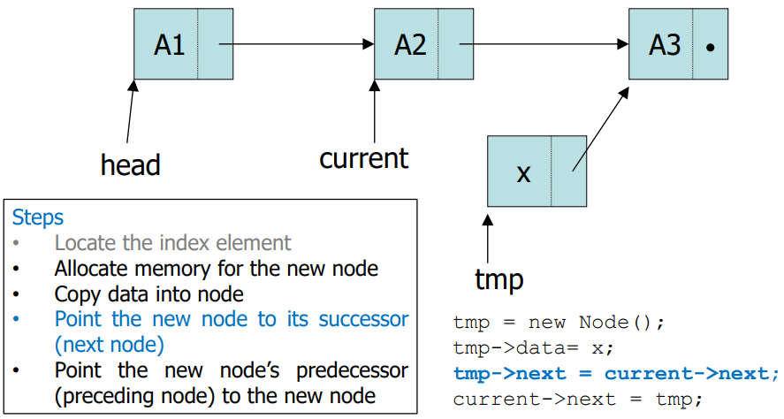
Insertion At The Middle (4)
Suppose current points to the middle element of the list
We can add a new item x by doing this

Slide 19
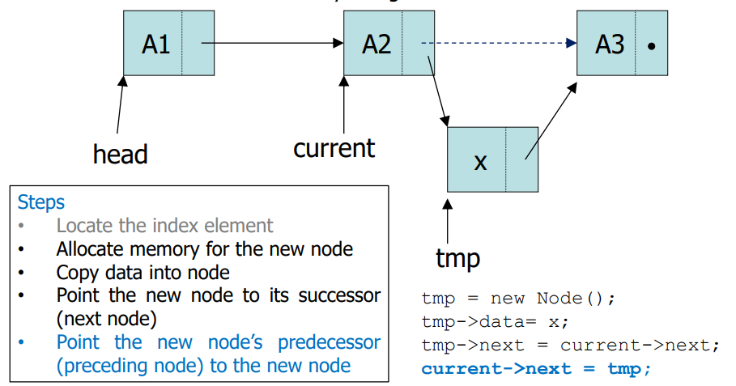
Insertion At The Middle (5)
Suppose current points to the middle element of the list
We can add a new item x by doing this

Slide 20
Inserting a New Node (2)
Possible cases of Insert
1. Insert into an empty list
2. Insert at front
3. Insert at back
4. Insert in middle
In fact, only need to handle two cases
Insert as the first node (Case 1 and Case 2)
Insert in the middle or at the end of the list (Case 3 and Case 4)

Slide 21
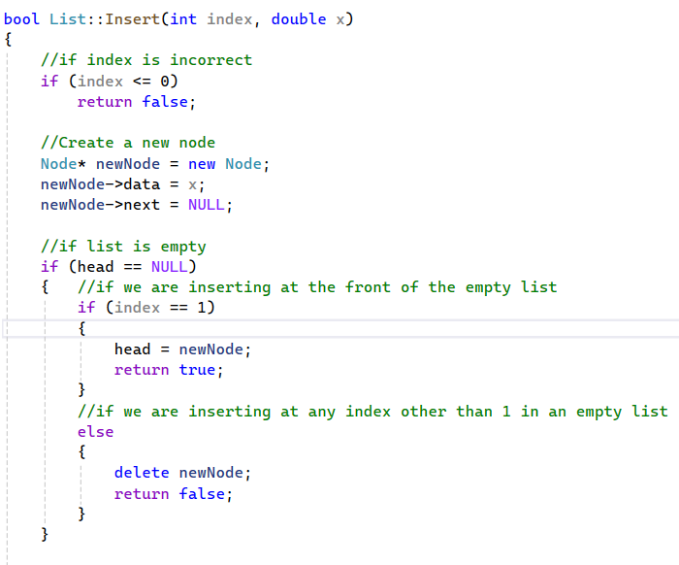
Inserting a New Node - Implementation

Slide 22
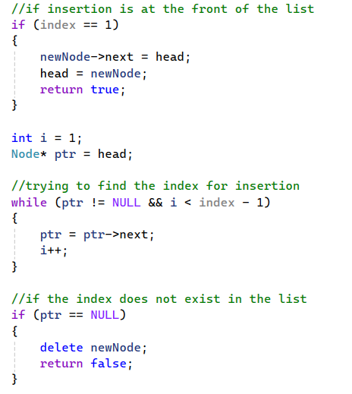
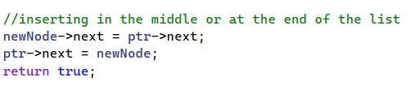
Inserting a New Node - Implementation

Slide 23
Deleting a node

Slide 24
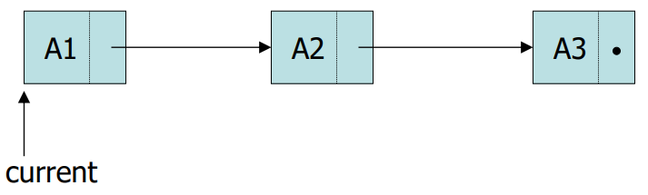
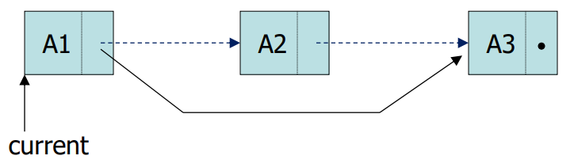
Deleting a Node – Example (1)
Deleting item A2 from the list

Slide 25
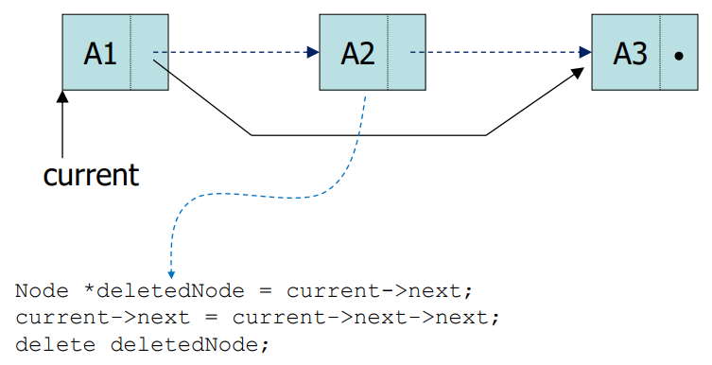
Deleting a Node – Example (2)
Deleting item A2 from the list

Slide 26
Deleting a Node – Implementation (1)
int Delete(double x)
Delete a node with the value equal to x from the list
If such a node is found return its position, Otherwise, return 0
Steps
Find the desirable node (similar to Find)
Release the memory occupied by the found node
Set the pointer of the predecessor of the found node to the successor of the found node
Like Insert, there are two special cases
Delete first node
Delete the node in middle or at the end of the list

Slide 27
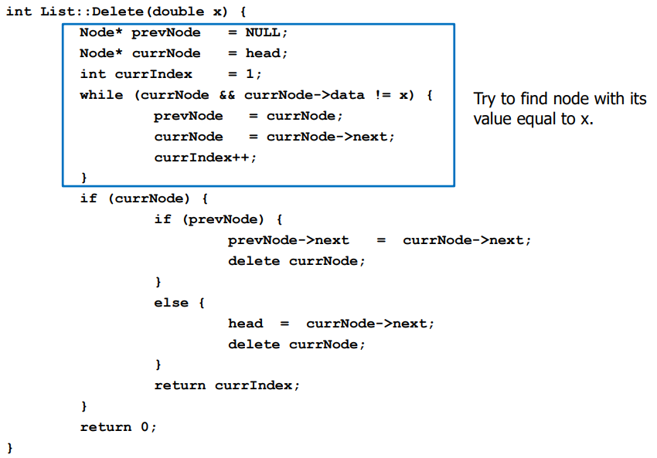
Deleting a Node – Implementation (2)

Slide 28
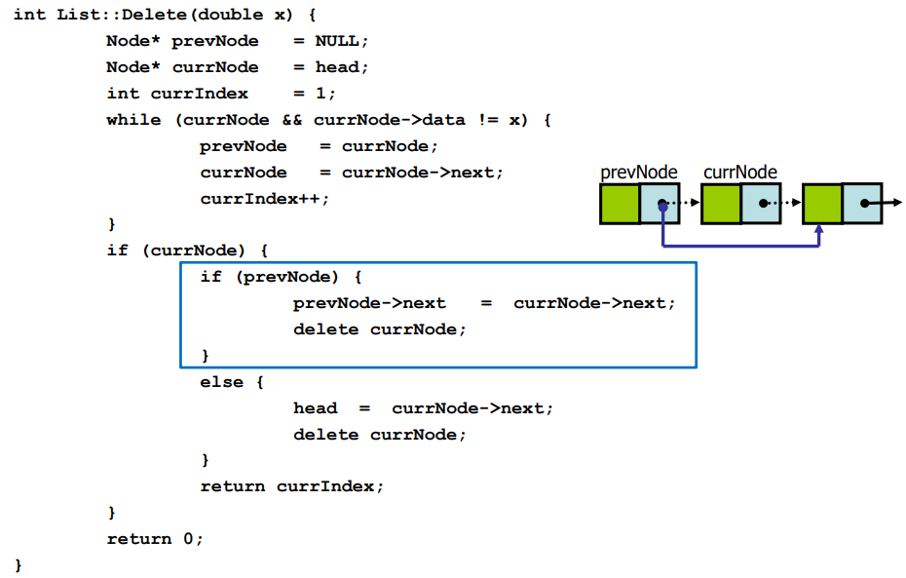
Deleting a Node – Implementation (3)

Slide 29
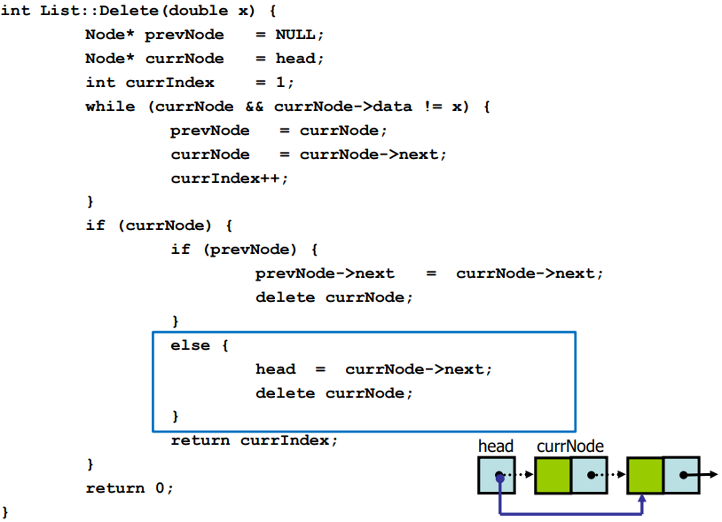
Deleting a Node – Implementation (4)

Slide 30
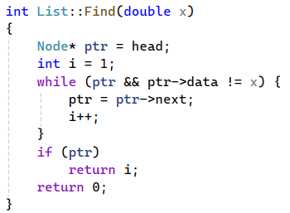
Finding a Node
int Find(double x)
Search for a node with the value equal to x in the list
If such a node is found: Return its position, Otherwise, return 0

Slide 31
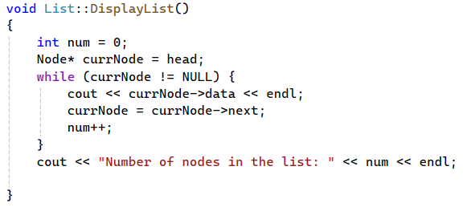
Printing All The Elements
void DisplayList(void)
Print the data of all the elements
Print the number of the nodes in the list

Slide 32
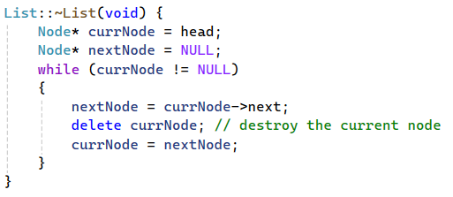
Destroying The List
~List(void)
Use the destructor to release all the memory used by the list
Step through the list and delete each node one by one

Slide 33
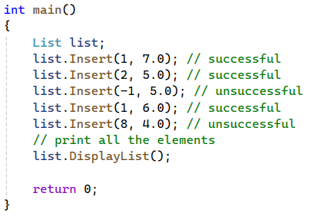
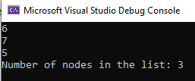
Using List (1)

Slide 34
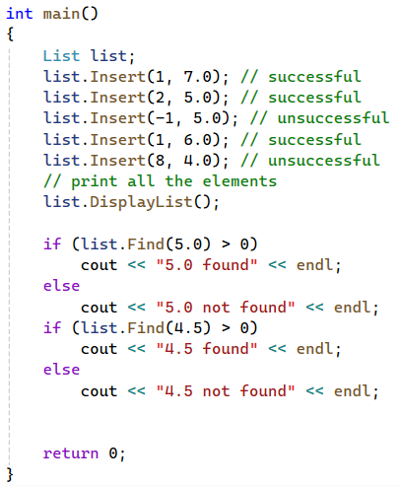
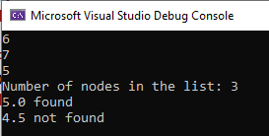
Using List (2)

Slide 35
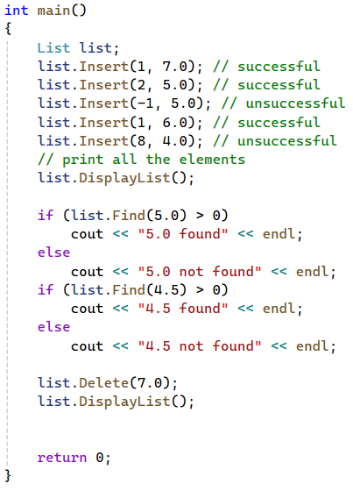
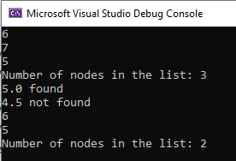
Using list (3)

Slide 36
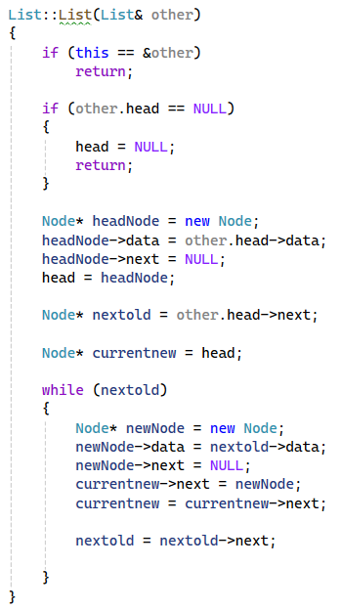
Copy Constructor

Slide 37
Templates
Will be covered in Lab (14th March, Friday, Week 5)

Slide 38
Analysis

Slide 39
int Get(int index); //retrieve the data at index
bool Search(int value); //check if data is present in linked list
bool Insert(int data, int index);
Insertion in empty list
Insertion at head
Insertion in the middle
Insertion at the end
int remove(int index);
Removal from the head
Removal from the middle
Removal from the end

Slide 40
get(i) is slow: O(N). We need to perform sequential access from head element.
search(v)
In the best case, v is found at the first position, O(1).
In the worst case, v is not found in the list and we require O(N) scan to determine that.
insert(i, v)
In the best case, insert at i = 0 or at i = N, head and tail pointers help, O(1).
In the worst case, insert at i = N-1, we need to find the item N-2 just before the tail, O(N).
remove(i)
In the best case, remove at i = 0, head pointer helps, O(1).
In the worst case, remove at i = N-1, due to the need to update the tail pointer, O(N).

Slide 41
Any Questions?

